Slide 1
DETECTING WEB ATTACKS WITH END-TO-END DEEP LEARNING

Slide 2
Abstract
Web applications are popular targets for cyber-attacks because they are network-accessible and often contain vulnerabilities. An intrusion detection system monitors web applications and issues alerts when an attack attempt is detected. Manually selecting features, however, is time-consuming and requires in-depth security domain knowledge.

Slide 3
Introduction
Web applications are attractive targets for cyber attackers. SQL injection , cross site scripting (XSS) and remote code execution are common attacks that can disable web services, steal sensitive user information, and cause significant financial loss to both service providers and users.

Slide 4
Existing System
Our approach applies deep learning to the entire process from feature engineering to prediction, i.e., raw input is fed into the network and high-level output is generated directly. Our work is motivated by the success deep learning has achieved in computer vision ,speech recognition ,and natural language processing.

Slide 5
Disadvantages
low-level.
Time-consuming and requires in-depth security domain knowledge.

Slide 6
Proposed System
Traditional intrusion detection systems apply rule-based approach where users must have domain-specific knowledge in web security. Experienced security experts are thus needed to determine what feature(s) are relevant to extract from network packages, binaries, or other input for intrusion detection systems.

Slide 7
Advantages
live applications.
control flow, fine-grained (branch) control flow, exception flow, and annotation driven information capture.
online model construction.

Slide 8
System Requirements
Software requirements
Operating System - Windows XP
Coding Language - python

Slide 9
Hard Ware Requirements:
Processor : Pentium-III (or) Higher
Ram : 64MB (or) Higher
Cache : 512MB
Hard disk : 10GB

Slide 10
System design

Slide 11
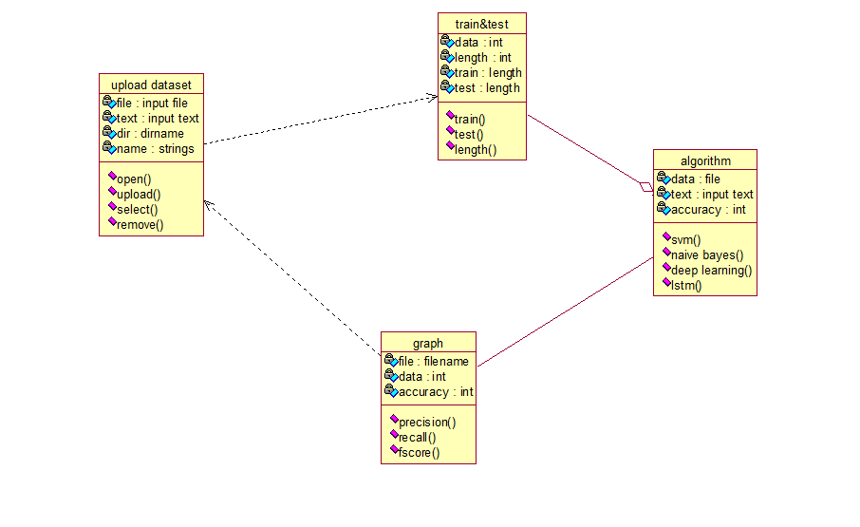
Class diagram

Slide 12
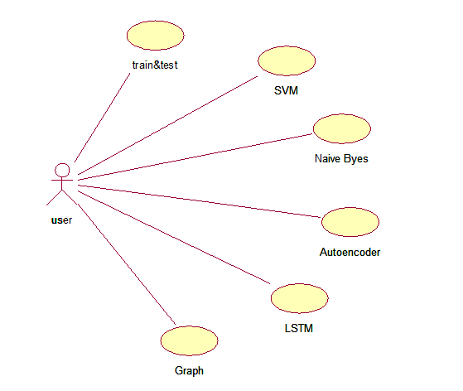
Use case diagram

Slide 13
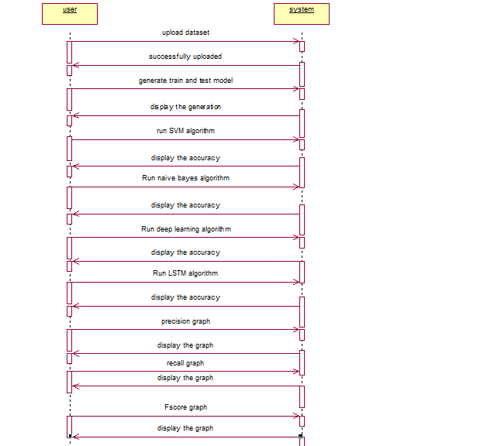
Sequence diagram

Slide 14
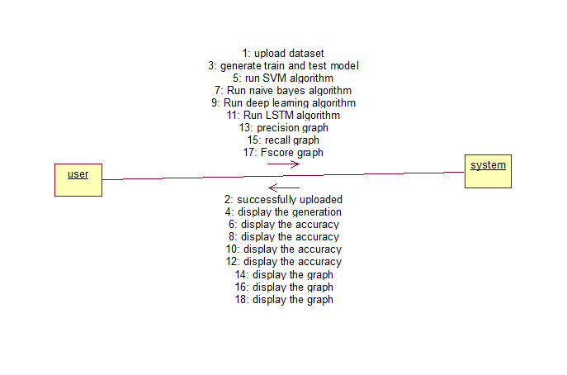
Collaboration diagram

Slide 15
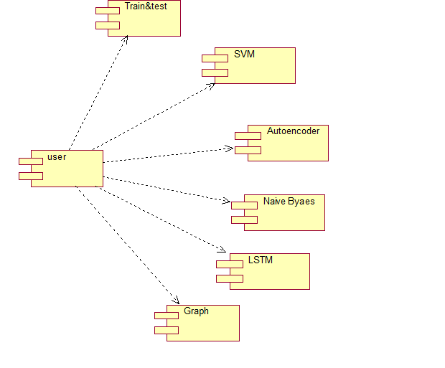
Component diagram

Slide 16
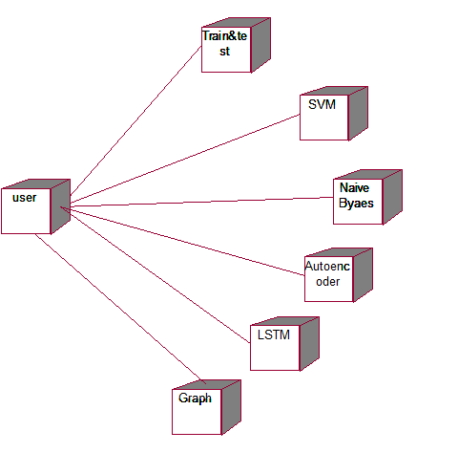
Deployment diagram

Slide 17
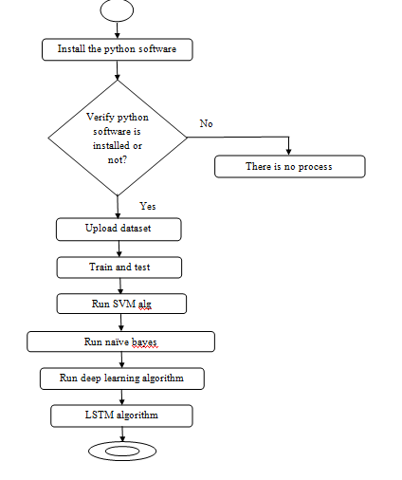
Activity diagram

Slide 18
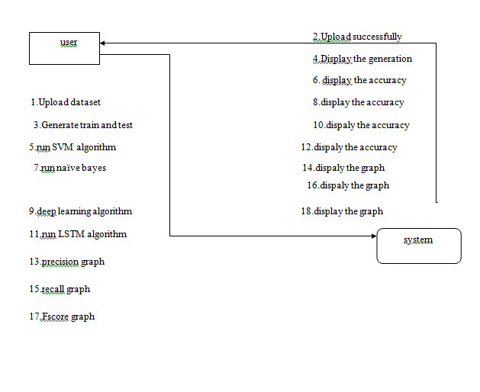
Data flow diagram

Slide 19
Output Screens

Slide 20
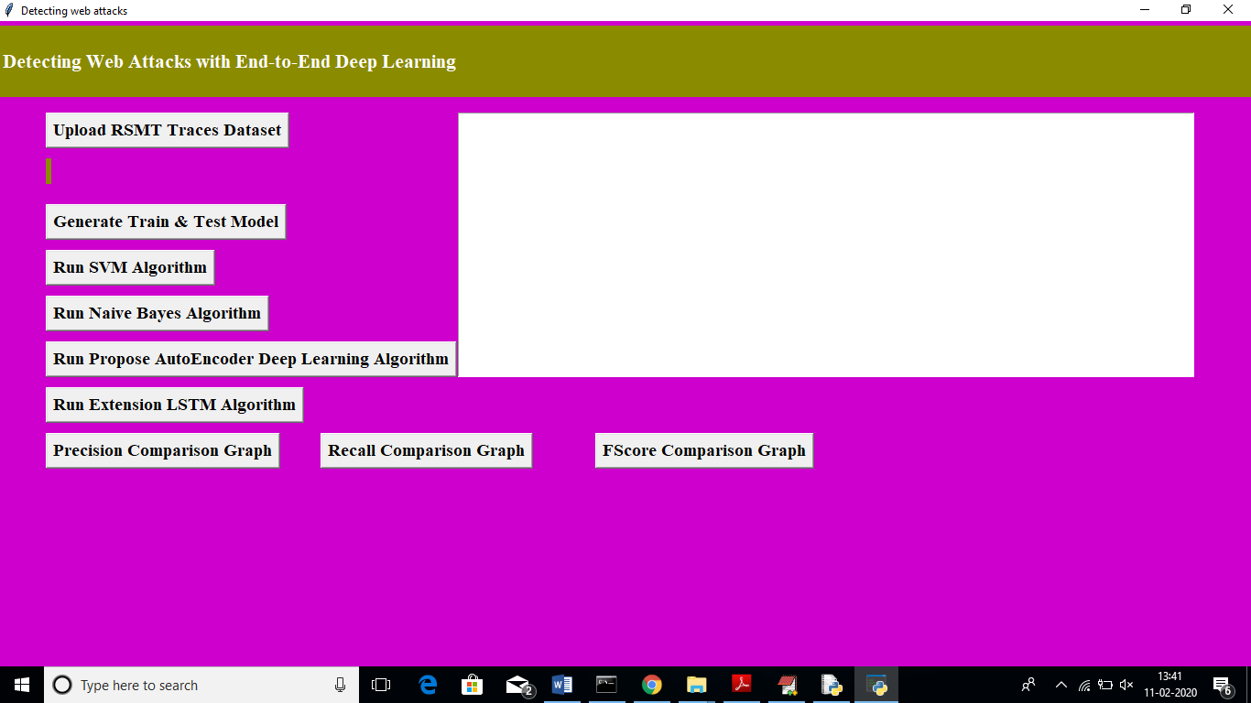

Slide 21
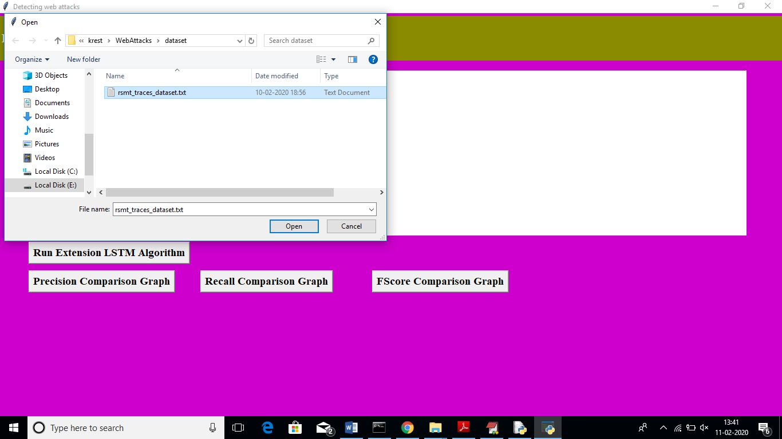
upload attack traces

Slide 22
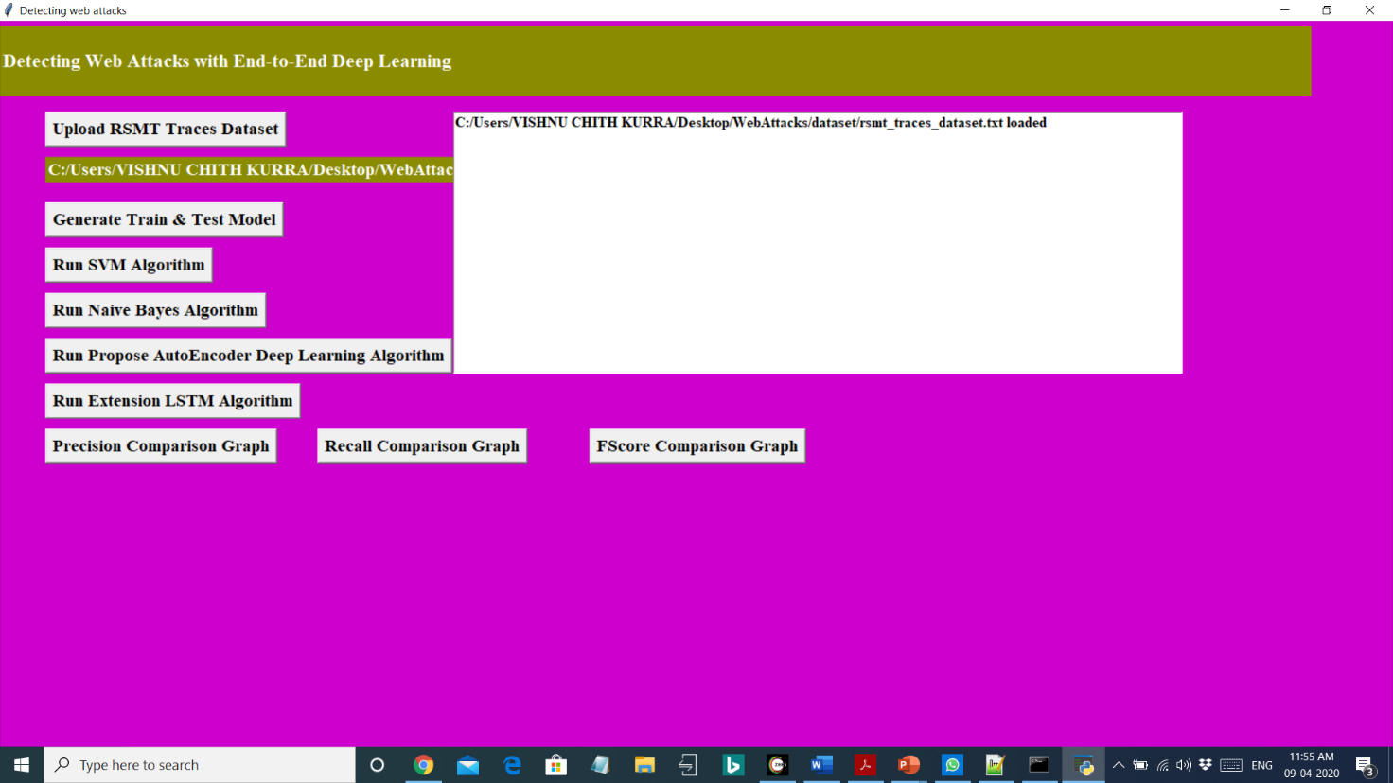
uploading dataset will get below screen.

Slide 23
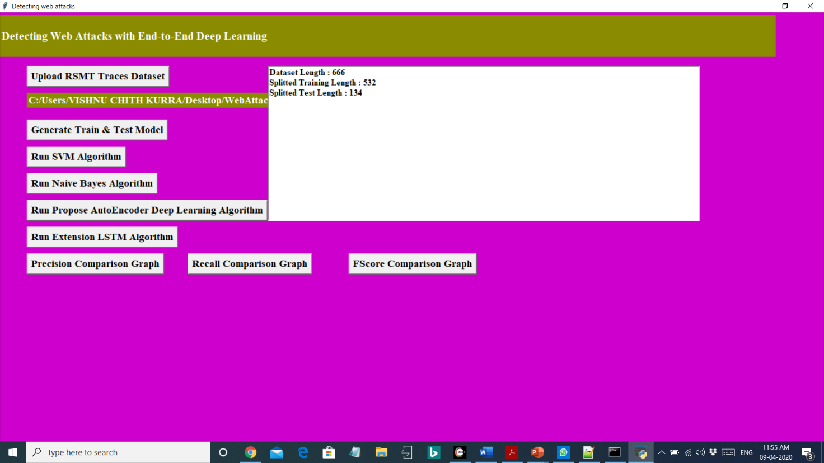

Slide 24
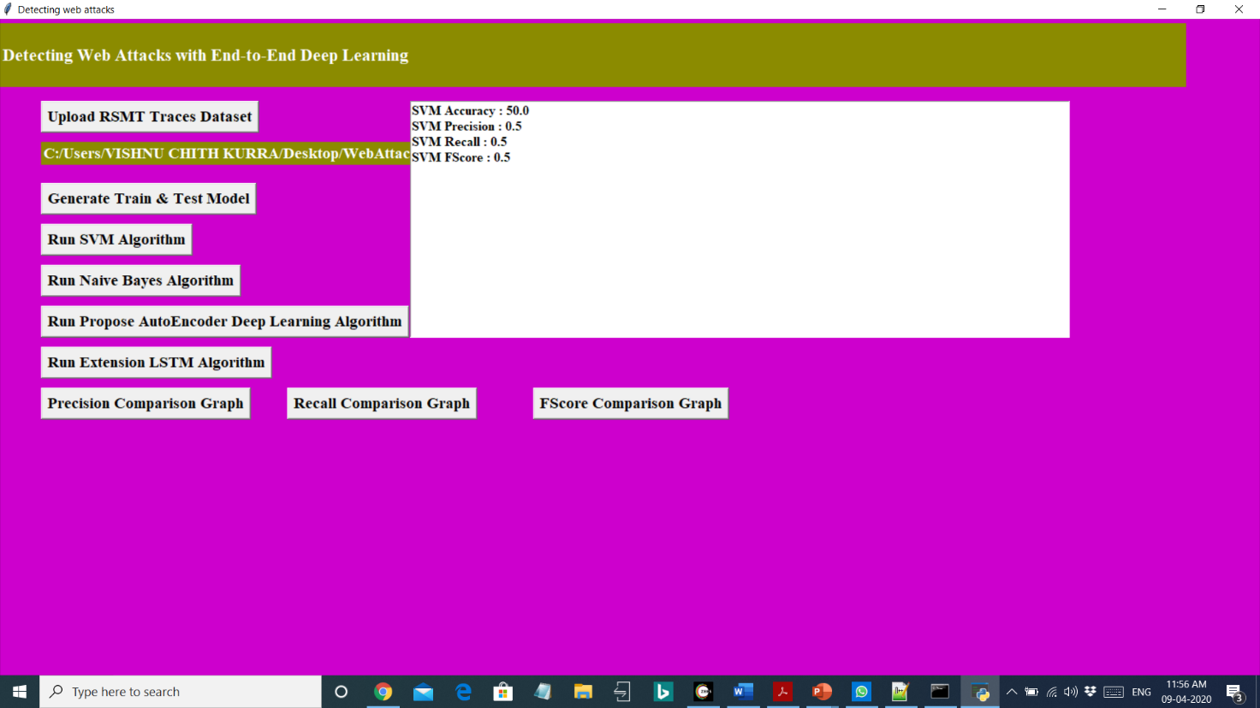
After uploading dataset click on ‘Generate Train & Test Model’ button to generate train and test data.

Slide 25


Slide 26
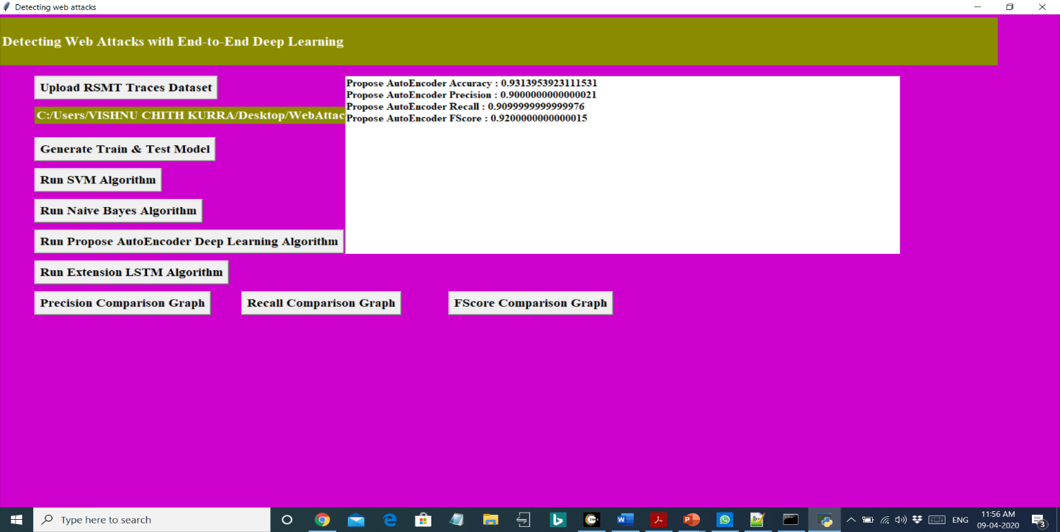
Now click on ‘Run SVM Algorithm’ button to generate SVM model on train data and calculate precision, recall on test data.

Slide 27


Slide 28
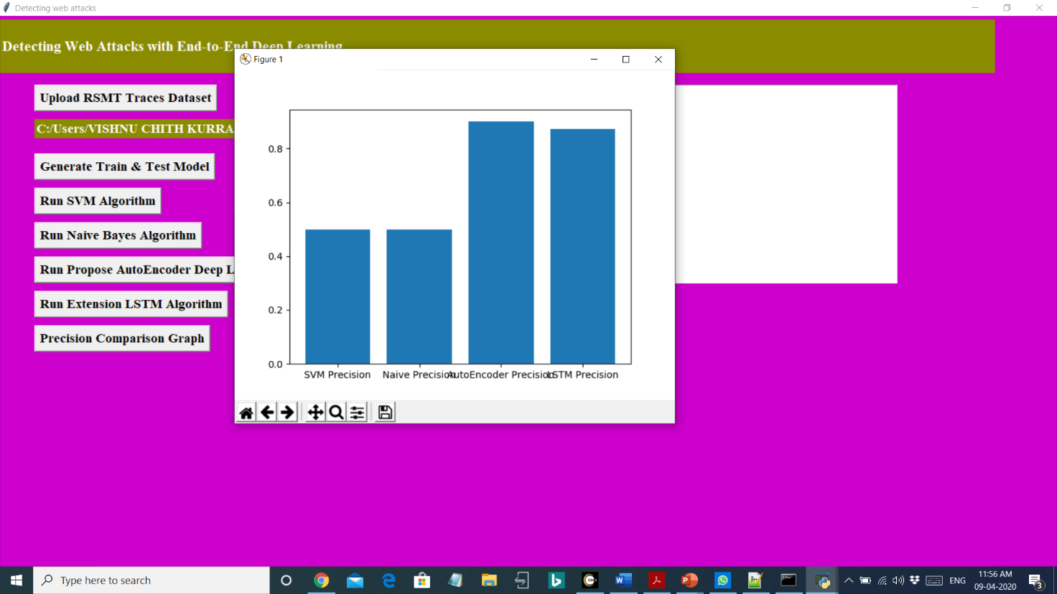
Now click on ‘Naïve Bayes Algorithm’ button.

Slide 29
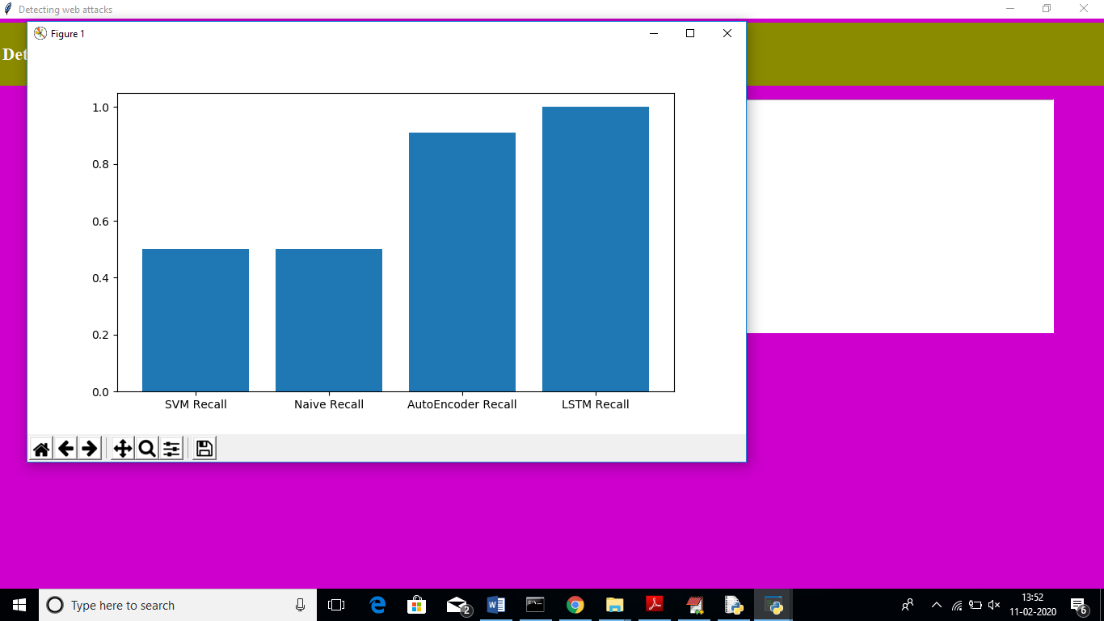

Slide 30
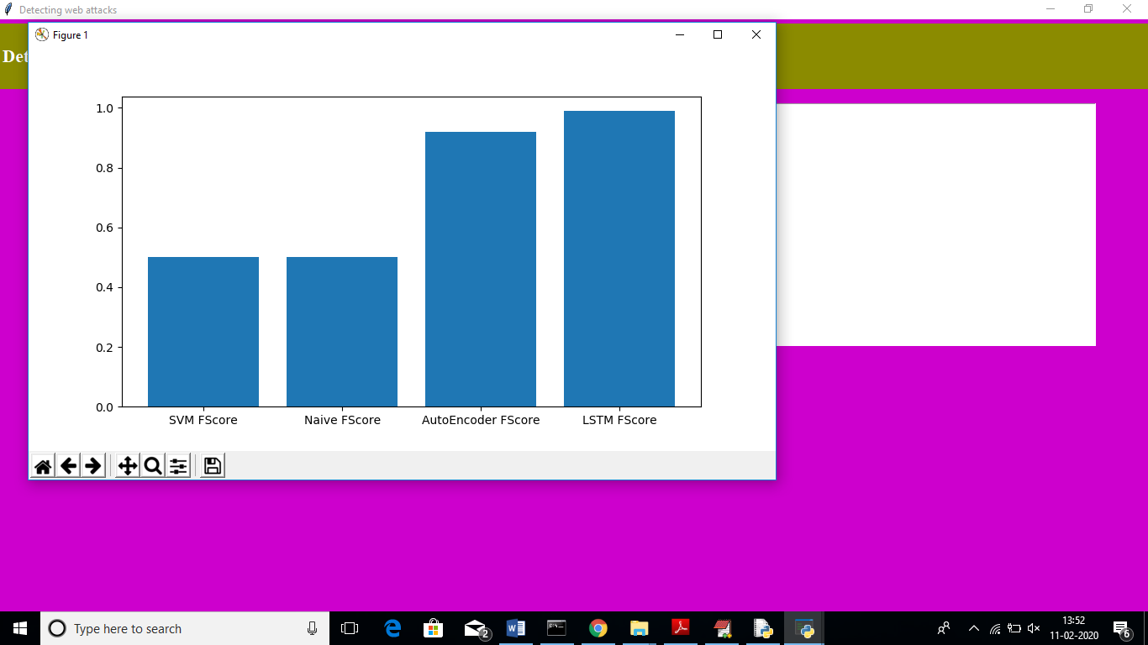
click on ‘Run Propose Auto Encoder’ button to run propose algorithm.

Slide 31
Conclusion
We described the architecture and results of applying an unsupervised end-to-end deep learning approach to automatically detect attacks on web applications. We instrumented and analyzed web applications using the Robust Software Modeling Tool (RSMT), which autonomically monitors and characterizes the runtime behavior of web applications. We then applied a denoising autoencoder to learn a low-dimensional representation of the call traces extracted from application runtime. To validate our intrusion detection system, we created several test applications and synthwetic trace datasets and then evaluated the performance of unsupervised learning against these datasets. We have also used some complex network structures such as Long Short-Term Memory (LSTM) or autoencoders with CNNS for providing better accuracy for web attack detection tasks

Slide 32
Thank you…

